Slide 1

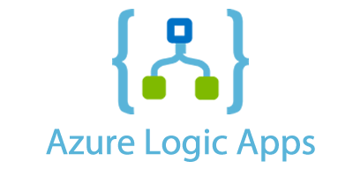

Background Processing
Hangfire v Microsoft Logic Apps
Notes:
* Hangfire doesn’t really have a logo…

Slide 2


Joel Viney
Team Lead at QuillGroup
Software developer for 20 years
Developing Azure on and off 4 years
https://github.com/JoelViney
Notes:
Accounting, Financial Planning and Superannuation services.
Ive been developing professional for 20+ years
Dabbled with Azure on and off for 4 years
I’ve had to deal with background processing, batch jobs for that entire time
I skipped the wedding profile photo this time…

Slide 3
Background Processing
Azure Scheduler
“Azure Scheduler will retire on September 30, 2019”
Azure Logic Apps
“Azure Logic Apps is a cloud service that helps you automate and orchestrate tasks, business processes, and workflows when you need to integrate apps, data, systems, and services across enterprises or organizations”
Hangfire
“An easy way to perform background processing in .NET and .NET Core applications. No Windows Service or separate process required. Backed by persistent storage. Open and free for commercial use.”
Notes:
Today I am going to talk background processing, background jobs, scheduled tasks, cron jobs what ever you want to call them.
I am going to do this by going over two products in the industry right now that seem like the obvious choices.
Azure Scheduler is dead.
Azure Logic Apps
“Azure Logic Apps is a cloud service that helps you automate and orchestrate tasks, business processes, and workflows when you need to integrate apps, data, systems, and services across enterprises or organizations”
Hangfire
“An easy way to perform background processing in .NET and .NET Core applications. No Windows Service or separate process required. Backed by persistent storage. Open and free for commercial use.”
Im going to cover Hangfire and Azure Logic Apps
History:

Slide 4
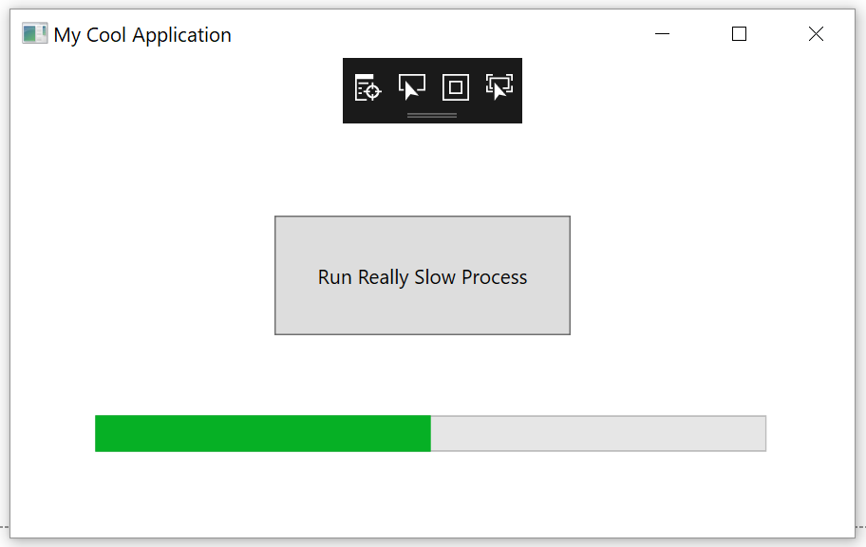
My History with Background Processing
Button -> Manually Triggering Job
Windows Scheduler
Windows Service
Azure Scheduler -> Azure Job
Azure Scheduler -> Http Endpoint
Hangfire
Notes:
Scheduling background jobs is something that every developer will come across at some stage. In the past I've used or worked on:
* Manually triggering a batch job at the start of the day.
Easish, you still need progress bars
Annoying for the end user
Session timeout issues for web based applications
* Windows Scheduler (to trigger an exe)
Double the Installation - Issues keeping your production / job code synchronized.
I just felt dirty
* Windows Service
Installation is a pain in the ass
Issues keeping your production / job code synchronized.
* Azure Scheduler -> Azure Jobs
The same, it was a pain in the arse although easier to report on
Installation issues
* Azure Scheduler -> Triggering an http endpoint
Session timeout issues? Security issues
Uses websites resources
* Hangfire
Easy to install
Uses websites resources

Slide 5

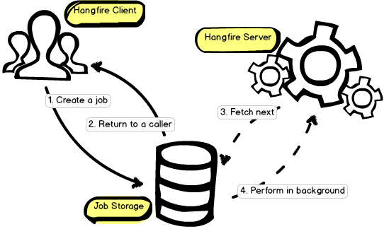
https://www.hangfire.io/
Open Source
Easy to install…. Mostly
.Net 4.5 and .Net Core
Database storage
Run on dedicated threads
Will scale out
Automatic Retry
Notes:
Hangfire allows you to kick off method calls outside of the request processing pipeline in a very easy, but reliable way.
These method invocations are performed in a background thread and called background jobs.
Not much to it really…. It just does scheduling!

Slide 6
Hangfire Installation

Slide 7
Hangfire – Job Types
asdasd

Slide 8
Hangfire Dashboard

Slide 9

“In 2016, we launched Azure Logic Apps, which includes the ability to configure and run scheduled jobs as well as advanced workflow features other stuff.”
Microsoft Flow
Workflow engine
Notes:
In 2016, we launched Azure Logic Apps, which includes the ability to configure and run scheduled jobs as well as advanced workflow features.
Workflow engine

Slide 10


Slide 11
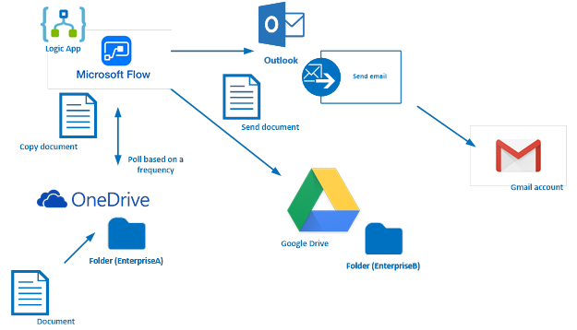
Azure Logic Apps
Notes:
"Automate many of the workflows you have in place, without writing a single line of code"

